Slide 1
Student Leadership Opportunities in Mathematics
- James Dann

Slide 2
About your experience…
What have Maths Clubs looked like at your school?
3 minutes:
30-45 seconds each
Discussion

Slide 3
Maths Clubs & Peer Mentoring
Background – my story.
Why…is it important?
How…is it achieved?
What…does it look like?

Slide 4
Two schools
One theme
Student-led
My Story

Slide 5
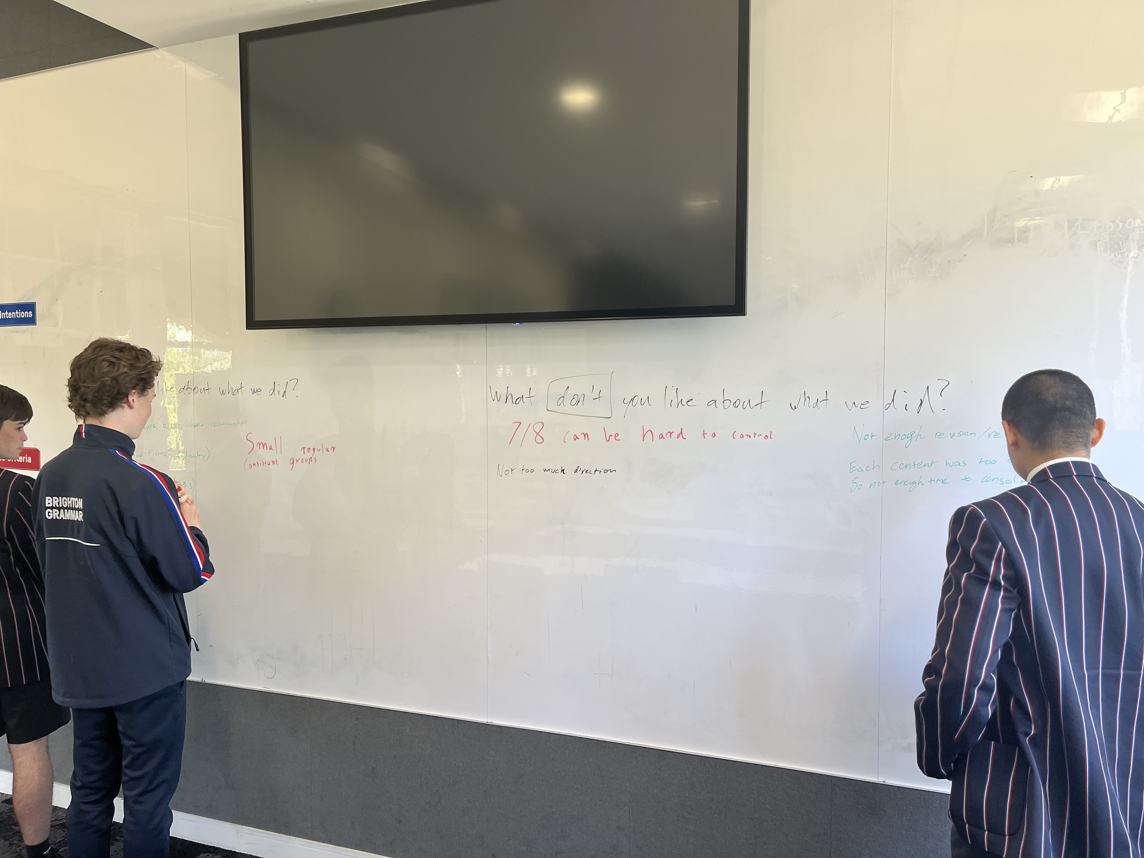
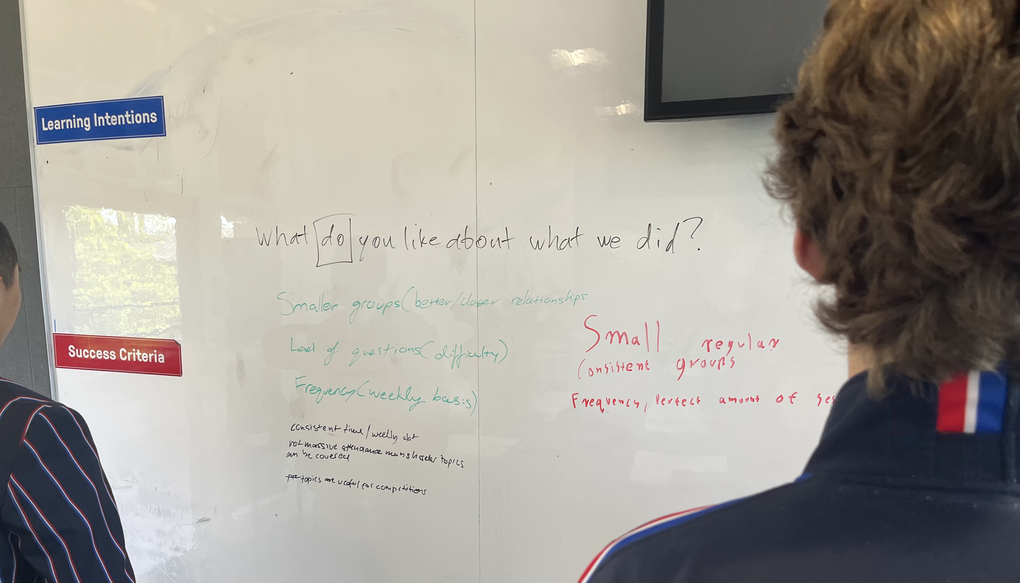
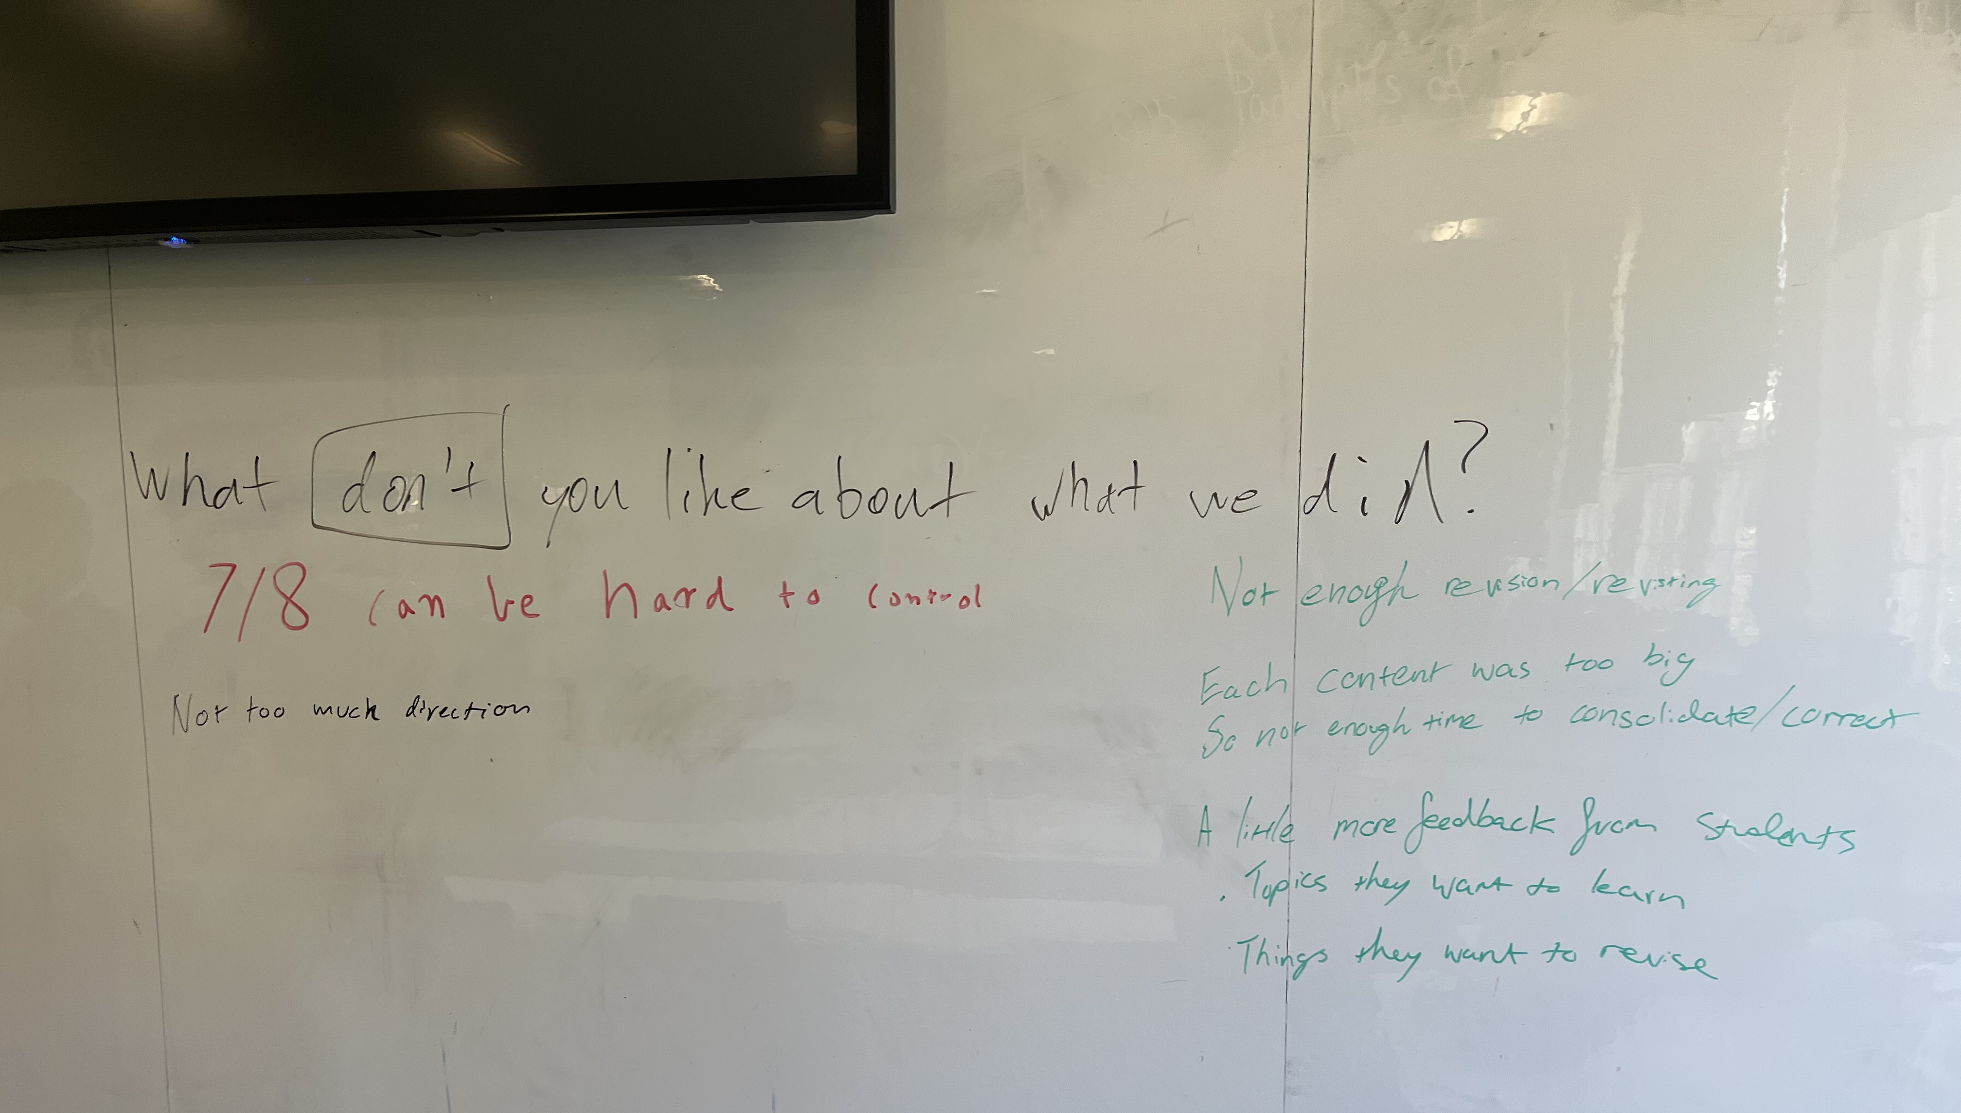
Two schools
One theme
Student-led
My Story
This brings us to…
This year’s Year 11 Maths Club leaders planning for next year.

Slide 6
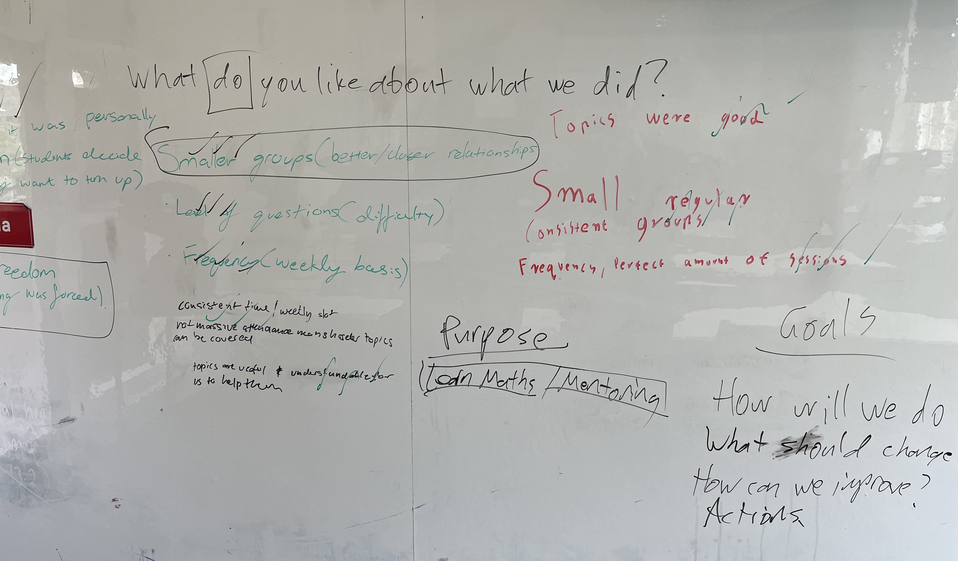
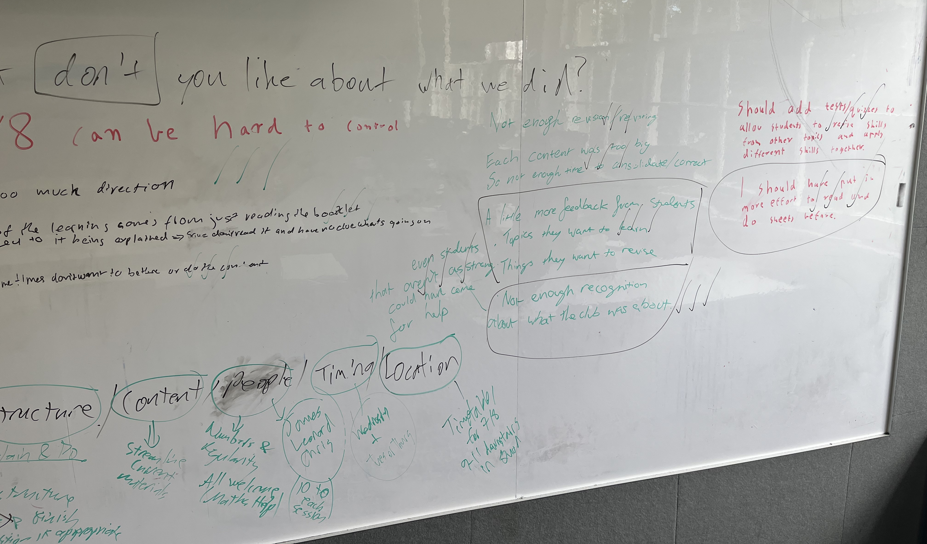
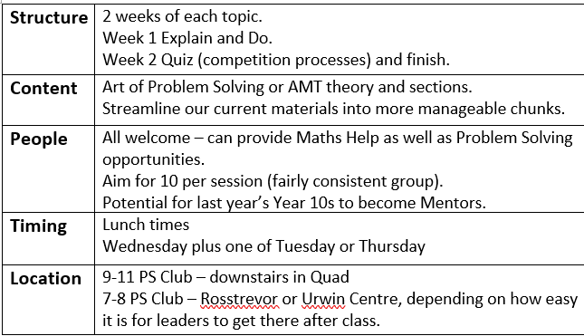

Slide 7
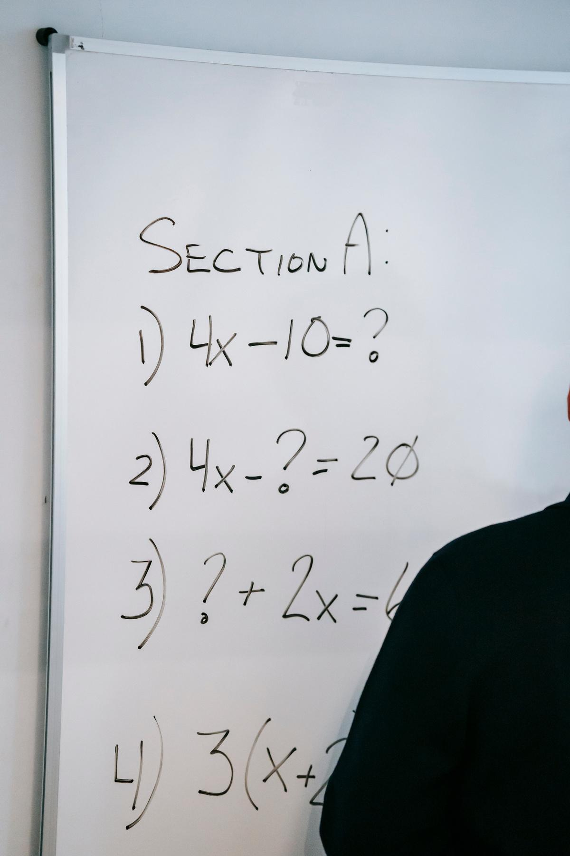
Maths Clubs & Peer Mentoring
Questions
Why is it important?
Who benefits?

Slide 8
Mentors (leaders)
Refine their knowledge by explaining concepts.
Mentees
Role-models and learning outside curriculum.
Teachers
Less differentiation of the highest achievers during class time.

Slide 9
Finding your leaders
Table Discussion
What Maths competitions does your school enter?

Slide 10
Competition Opportunities – Inexhaustive list, but I can answer questions about these…
Individual Competitions – One Day
March: Kangourou Sans Frontieres (Australian Maths Trust)
May: Melbourne University School Maths Olympics (Melb Uni Maths Dept.)
August: Australian Maths Competition (AMT)
September: Australian Intermediate Maths Olympiad (AIMO)
Individual Competitions – Multi-day/week
March-June: Maths Challenge for Young Australians Challenge Stage (AMT)
April-October: MCYA Enrichment Stage (AMT)
Team Competitions
March-August: Maths Olympiad (APSMO)
August: School Maths Olympics (Melbourne Uni Maths Students Society)

Slide 11
Maths Clubs & Peer Mentoring
Question
How do you get students to “give up their lunch time”?

Slide 12
Maths Clubs & Peer Mentoring
Question
What does it look like/sound like/feel like?

Slide 13
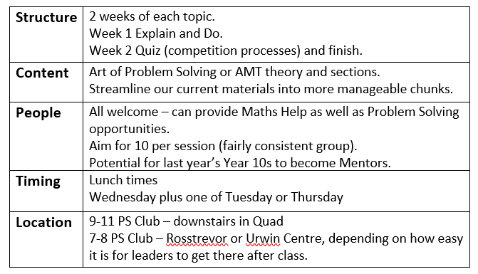
What does it look like/sound like/feel like?
It is…
Regular (every week)
Consistent (location, format of the delivery, theory, number of questions)
Low stakes (with buy in, the competition between participants will form on its own)
Convenient (lunch times are limited)

Slide 14
Time to brainstorm!
How are you going to find your leaders?
What is your desirable Structure, Content, People, Timing and Location(s)?
Thank you for listening.

